Slide 1

El Monte union high school District
BOND update
February 2020

Slide 2
Measure D Bond- $148 Million
2008 Election
Bond Series | Issue Date | Principal Amount
Series A | 6/16/2009 | $54,001,305.
Series B | 6/02/2011 | $30,000,000.
Series C | 4/08/2016 | $ 5,238,885.
Series D | 11/21/2017 | $10,196,955.
Total Issue Amount |  | $99,437,146.
Cost of Bond Issuance |  | $ 1,684.319.
*Transfer in from other fund |  | $ 12,679,418.
Interest as of June 30, 2019 |  | $1,959,417.
Total Revenue |  | $112,391,662.
Total Expended as of January 30, 2020 |  | $94,105,486.
Balance |  | $16,286,176.
*Reimbursements from State Match Funds, City of Rosemead, E-Rate & DGS

Slide 3
Measure HS Bond- $190 Million
2018 Election
Bond Series | Issue Date | Principal Amount
Total Issue Amount |  | $56,430,000
Cost of Bond Issuance |  | $365,000
Interest Collected |  | $0
Total Revenue |  | $56,065.000
Total Expended as of 7/01/19 |  | $163,000
Balance |  | $55,902,000

Slide 4
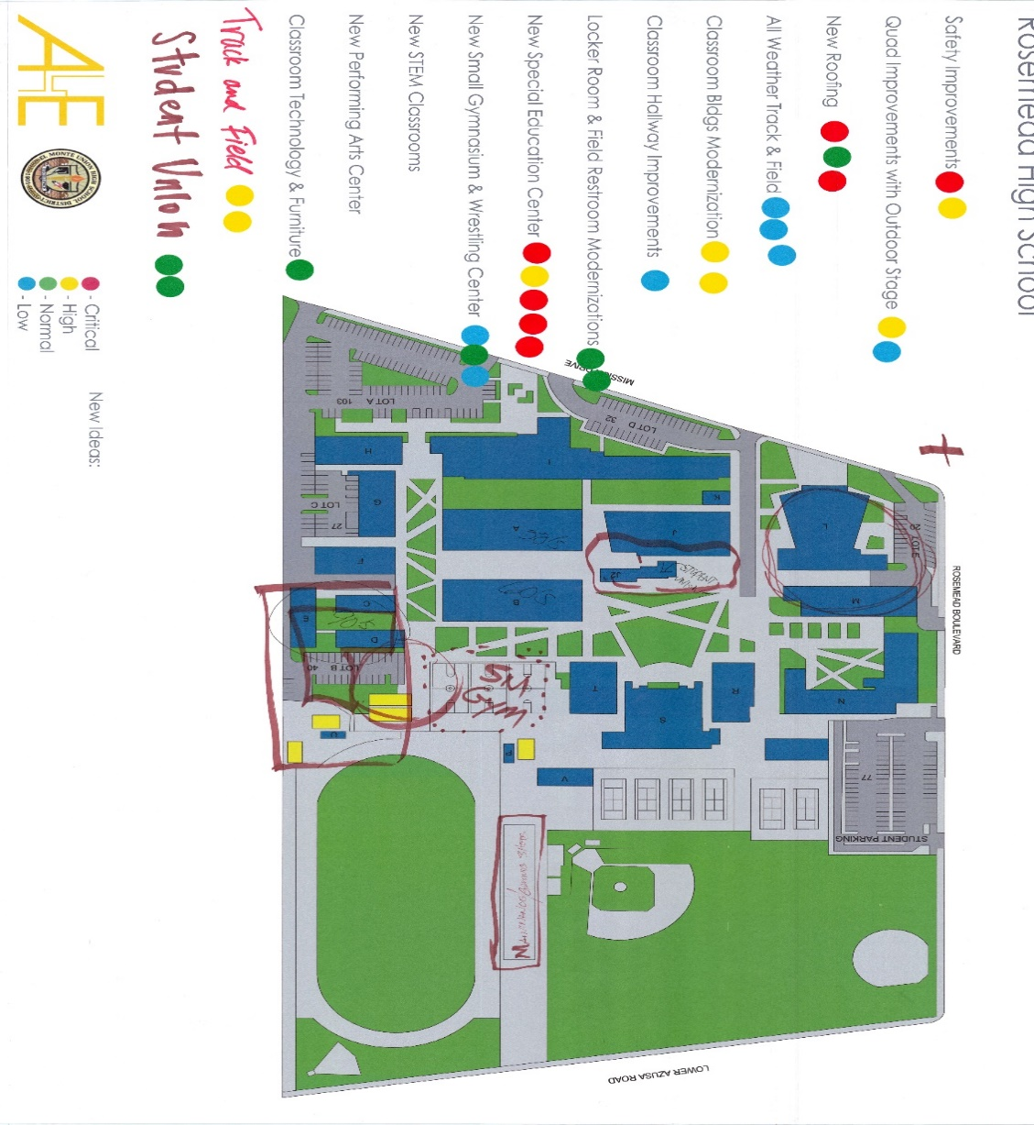
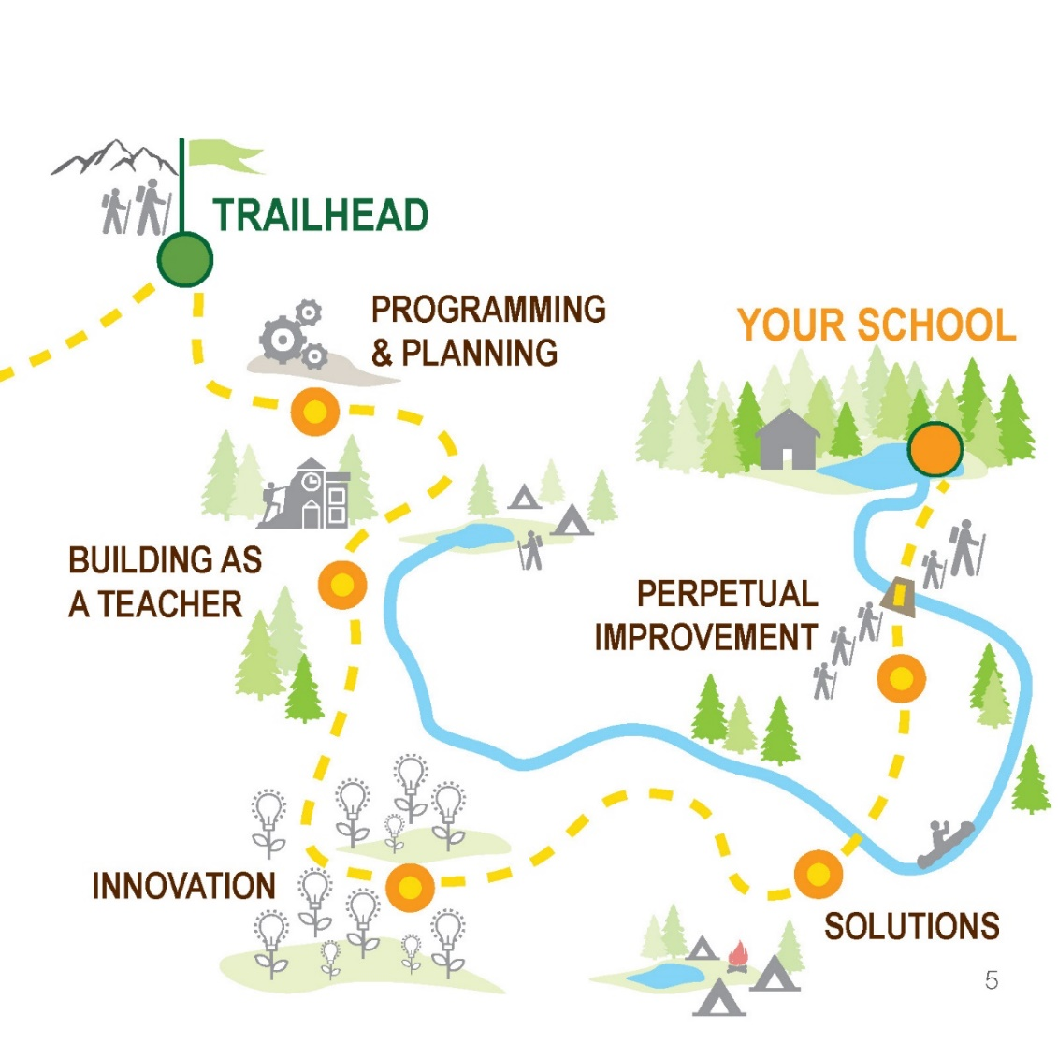
Priorities by School Site
Workshop 2 - Stakeholders Feedback

Slide 5
ARROYO HIGH SCHOOL
Main Office/MPR expansion & Modernization
  Expanded Performing Arts & CTE
  Expanded Administration
Stadium Upgrade
  All-weather Track + Field
  Snack Bar
  Visitor Bleachers
  Disability Access
Security Improvements
  Security Cameras
  Fire Protection
  Security Card Access
  Alarms
  Fencing

Slide 6
EL MONTE HIGH SCHOOL
Safety Improvements
  Monitoring system
  Keyless entry
  Exterior Lighting
  Security Cameras
  Window and roof replacement
Physical education / Athletic facility modernization
  All-weather Track + Field
  HVAC in gymnasium
  Updated locker room
Auditorium Modernization
  Band and choir room modernization

Slide 7
GRANADA TRANSITION CENTER
New Facility as identified in workshop #1
Existing Facility Priorities
  Repaired Drainage
  Secured Entrances
  Accessible Restrooms

Slide 8
FERNANDO LEDESMA HIGH SCHOOL
New multi-purpose room
Expanded Science and Engineering Labs
Security measures
  Fire safety
  Security cameras
  Disability access

Slide 9
MOUNTAIN VIEW HIGH SCHOOL
Upgraded classrooms and girls locker room
  Security measures
  Upgrade facilities
Hardscaping and facility upgrades
  Security measures
  Disability access
Athletic and physical education facilities
  Bleachers
  All weather track and field
  Snack bars, bleachers, restrooms
  Security measures
  Disability access

Slide 10
ROSEMEAD HIGH SCHOOL
Facility maintenance
  Roof & Plumping repairs
  Electrical upgrades
  Disability access
Safety measures
  Gates and fencing / Security Cameras / Disability Access
  Emergency communication systems
  Smoke alarms and detectors
Classroom upgrades
  Engineering & science labs
  Relocatable replacements
  Special education center

Slide 11
SOUTH EL MONTE HIGH SCHOOL
Gymnasium modernization
  Roof repairs, HVAC, Plumbing & Electrical improvements
  Locker room replacement
  AV upgrades
Athletic Stadium Improvements/All weather track and field
  Disability access
  New ticket booth with improvement (home/visitor access)
  Security cameras
  Curb appeal
Quad renovation
  Shade shelters
  Disability access
  Security & monitoring systems

Slide 12
POTENTIAL MATCHING STATE FUNDS
Arroyo HS mod: $6,916,266
El Monte HS mod: $7,904,304
Fernando Ledesma HS mod: $2,634,768
Mountain View HS mod: $13,997,205
Rosemead HS mod: $7,410,285
South El Monte HS mod: $8,562,996
Special Education new: $21,737/$32,503 per student
Special Education mod: $9,391/$14,097 per student
New Schools Facilities State Bond is Scheduled this Year
(Consultant: HMC Architect to Re-establish Eligibility)

Slide 13
BOARD APPROVED PROJECTS
Fernando Ledesma HS (Board approved the Construction bid in September 2019)
Security Upgrades (Locks, surveillance & schools single point of entry, Gates & fences) for all District sites
Immediate Infrastructure Upgrades as needed to supplement Deferred Maintenance annual budget. Scope includes but not limited to: roofing, HVAC gym addition, plumping, flooring, lighting including classroom Solar Tube
Artificial Track & Field Replacement for 2 school sites besides Rosemead HS
Snack Bar Replacement – 2 sites besides Rosemead HS
Rosemead HS Snack Bar Replacement
Furniture Replacement for the next 3 Years
Planning & Design for the following projects: Full MVHS modernization, SEMHS modernization and Granada Transition New Construction. The scope includes extensive infrastructure, indoor and outdoor upgrades and updates for MVHS & SEMHS as well as New Campus for Transitional Center
State & Local Agency Approvals (DSA / OPSC / Utilities / Cities) – MVHS, SEMHS, Granada Transition
Start of Granada Transition Construction
HVAC & Energy Management Systems Group C-2
Various sites Parking Area improvements & Upgrades including resurfacing, Solar equipped parking covers with Solar Battery Storage at El Monte HS, Ledesma and other district campuses

Slide 14
MEASURE HS FUTURE PROJECTS
QUICK START PROJECTS
Plumbing Replacement & Girls Locker Modernization at Mountain View High School
New Track & Field at Two High Schools
Security Upgrades District Wide
New Snack Bars at Arroyo & Mountain View HS
Furniture Replacement
PLANNING PROJECTS
Mountain View High School Modernization
South El Monte High School Modernization
New Facility for Granada Transition Center
Energy Efficiency Projects

Slide 15
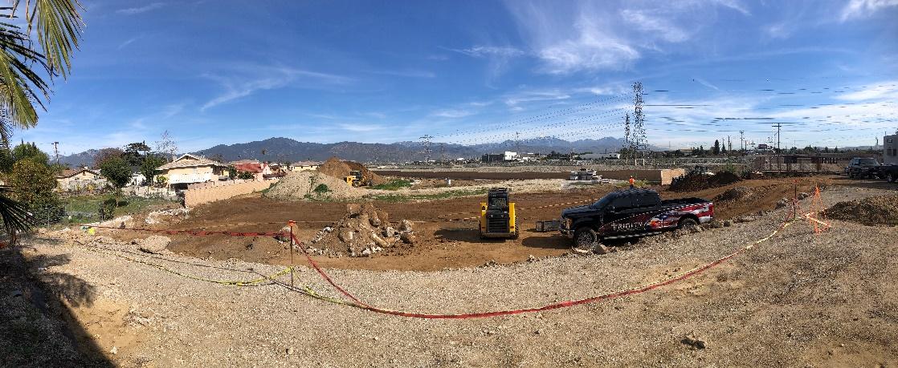
Fernando Ledesma High School
Multi-Purpose Building
Project Designed by Architecture for Education
Awarded to The Nazerian Group $10,450,00.
Construction began in October
Groundbreaking on December 11th at 4 pm
Completion Date: Summer 2021
Project will include: New gymnasium space, full basketball court and bleachers, classrooms, weight room, restrooms, kitchenette, offices and new exterior site improvements

Slide 16
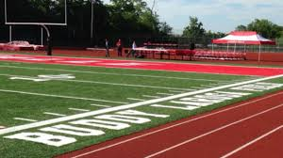
Rosemead High School
New Track and Field
Project will be designed by LPA
Estimated Total Cost of Project: $5,000,000.
Board approved the contract to procure materials at December meeting
Project Schedule
  Design Development – January 2020 to March 2020
  Construction Documents/ Agency Approval – March 2020 to October 2020
  Bidding/District Award – October 2020 to January 2021
  Construction Period – January 2021 to July 2021
Project will include:
installation of new synthetic football field
repair of rubberized track
new Snack Bars

Slide 17
Mountain View High School
Cafetorium Project
    Conceptual Design Completed
    Stage for Performing Arts
    Enhanced Acoustics
    Sound & Lighting
    Telescopic Seating
    Landscape Enhancements
    Project will begin once DSA
    Certification has been granted for
    Cafeteria Project
Bond dollars set aside for improvements:
$1,575,830

Slide 18
Rosemead High School
New Home & Visitor Concession Stand
NET ZERO ENERGY BUILDINGS
Anticipated Annual Energy Consumption 15,234 kWh per year
(both Buildings)
Anticipated Annual Power Production by PV Solar Array 15,600 kWh per year
Based on 1,025 SF

Slide 19
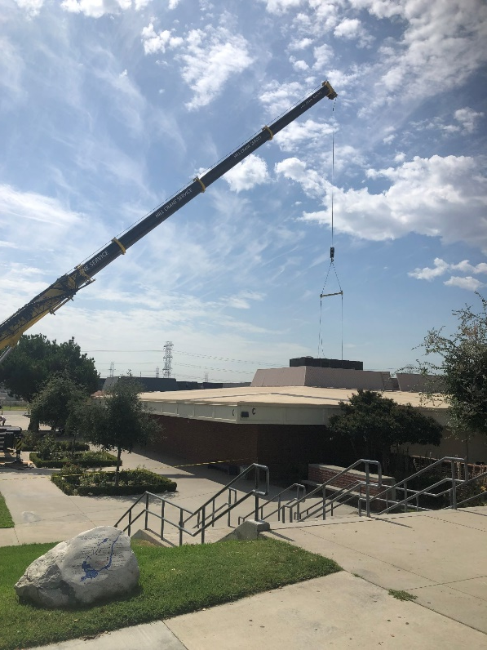
District Wide HVAC Project
Group C (Phase 1) – 98% Complete
Mountain View High School
Installed new Seasons Four units in Buildings C (Library), F (Music classrooms), and L (additional classrooms)
South El Monte High School
All units installed
El Monte High School
All units installed
Rosemead High School
75 % Complete
Adult School
All units installed
Completion Date: February 2020
Construction Cost of Project: $ 3,344,500.
Replacement of 155 HVAC units

Slide 20
District Wide HVAC Project
Group C (Phase 2) – Commencing Spring 2020
Mountain View High School
Installation of new HVAC units in Buildings A, B, & K
New system will eliminate Octagon rooftop units and replace with single classroom unit that will be located in the Ceiling
Interim Housing is required (Total of 8 classrooms will be used as Interim Housing)
In Process:
Procurement of HVAC Units (Approved by the Board in December 2019 ) $380K
Bid Opening (January 22, 2020)
Award of Construction Contract by Board at February 5, 2020 Meeting
Schedule of Construction (March to November 2020)

Slide 21
District Wide HVAC Project
Future Scope – TBD
Replacement of units at Granada Transition Center
New Controls District Wide
Cooling Towers
GYM HVAC Design for Arroyo HS / El Monte HS / Rosemead HS

Slide 22
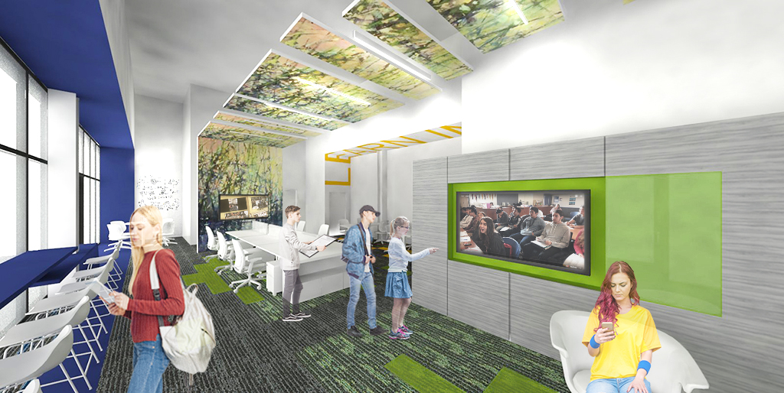
Community Education Center at District Office
Project Designed by Architecture for Education
Estimated Total Cost of Project: $1,000,000.
Project scheduled to begin by February 2020
Contractor was selected at December 2019 Board Meeting
Completion Date: Summer 2020
Project is for the creation of a new Community Education Center at the District Office. The Community Education Center will house 5 online teachers and one TOSA for new online high school program.

Slide 23
NEXT STEPS
Currently developing RFPs for Architectural Services to work on the following projects:
  Design: All weather track and field for Arroyo, El Monte, Mountain View & South El Monte High Schools (2 sites to be completed first pending funding)
    Administrative Staff recommends we hire Architect to design Track & Field for All High Schools
  Design: New Snack Bars for Arroyo High School
  Design: New Snack Bar, restrooms and bleachers for Mountain View High School
  Design: Modernization Project at Mountain View High School
  Design: Modernization Project at South El Monte High School
  Assessment of Granada Transition Center and Recommendations for Facility enhancement/replacement
  District wide assessment review and study of Baseball & Softball Fields
  Summer Projects:
  Mountain View High School Plumbing Project
  Rosemead High School exterior paint abatement project
  Roofing Replacement at Multiple Sites (Budget $1 to $2 Million)
  Flooring Replacement at Multiple Sites
  Surveillance Video Cameras: Installation of 80 Cameras at Various Sites
  Furniture replacement district wide

Slide 24
Timeline
  All weather track and field for Arroyo, El Monte, Mountain View & Rosemead High Schools (2 sites to be completed first pending funding)
    RFP to be issued on 2/7/20 - RFP due on 2/20/20 Board approval 3/4/20
  New Snack Bars for Arroyo High School
    RFP to be issued on 2/7/20 RFP due on 2/20/20 Board approval 3/4/20
  New Snack Bar, restrooms and bleachers for Mountain View High School
    RFP to be issued on 2/7/20 RFP due on 2/20/20 Board approval 3/4/20
  Modernization Project at Mountain View High School
    RFP to be issued on 2/14/20 RFP due on 3/13/20 Board approval 4/8/20
  Modernization Project at South El Monte High School
    RFP to be issued on 2/14/20 RFP due on 3/13/20 Board approval 4/8/20
  Assessment of Granada Transition Center and Recommendations for Facility enhancement/replacement
    RFP to be issued on 2/14/20 RFP due on 3/13/20 Board approval 4/8/20

